Slide 1

Introduction to Research Data Management
Welcome!
Thilo Paul-Stüve & Britta Petersen
Christian-Albrechts-Universität zu Kiel Forschungsdatenmanagement
paul-stueve@rz.uni-kiel.de
This work is licensed under a Creative Commons Attribution 4.0 International License with exception of the used material from other copyright holders.

Slide 2

Please be nice!
Please mute your microphone when you do not have the floor
Please hear each other out and let each other finish
Draw attention to yourselves when you want to say something
Please help each other
Please do not do anything on the side
Please ask if you have not understood something
Please contribute actively
Please allow mistakes -> positive culture of mistakes
Quelle: pixabay.com.
This work is licensed under a Creative Commons Attribution 4.0 International License with exception of the used material from other copyright holders.

Slide 3

Today goals
At the end of the workshop you…
have a basic idea of the general concept of RDM and know some important related terms.
can describe what research data is and know the research data lifecycle.
can explain the importance of documentation and know what metadata is.
can identify and assess data formats.
can distinguish back up and long-term storage.
can describe the FAIR-principles.
can describe what a DMP is.
know the requirements of funders and RDM related CAU contacts.
had some time to exchange with peers.
hopefully also had some fun!
Quelle: pixabay.com.
This work is licensed under a Creative Commons Attribution 4.0 International License with exception of the used material from other copyright holders.

Slide 4

Agenda
Expectations
Research data and research data management
Research data lifecycle
Data organisation
Documentation & metadata
Data formats
BREAK
Back up & long-term storage
FAIR principles and Open X
Data publication
Data management plan (DMP)
RDM related organisations & funder requirements
RDM @ CAU
Quelle pixabay.com
This work is licensed under a Creative Commons Attribution 4.0 International License with exception of the used material from other copyright holders.

Slide 5
WarmUp!
Let us play a game…
Hide your camera (use a sticker or your finger).
I will read statements to you.
Each time you can agree with the statement show yourself and waive.
That´s it !
This work is licensed under a Creative Commons Attribution 4.0 International License with exception of the used material from other copyright holders.
Notes:
I like to drink coffee in the morning.
I am doing my PhD in a subject of nature science.
I have a pet.
I live in Kiel.
I am doing my PhD in a subject of the humanities.
I have been annoyed by loss data before.
If I have to decide to go to a concert or to the cinema, I decide to go to the concert.
I am doing my PhD in a subject of engeneering.
I am a sporty person.
I have heard about the FAIR principles for data sharing before.
I have been sent to this workshop and I don't feel like it at all.

Slide 6
Expectations
What do you expect from this workshop?
– hopes/wishes and fears –
https://www.oncoo.de/0fou
This work is licensed under a Creative Commons Attribution 4.0 International License with exception of the used material from other copyright holders.

Slide 7
Research data & Research data management
Partner work:
You have five minutes with your partner.
Find out with what kind of data your partner is working with.
Together, collect everything that you think can be research data.
Please use the following pads to take notes during break out session:
https://zumpad.zum.de/p/2022-05-10_Researchdata_1
https://zumpad.zum.de/p/2022-05-10_Researchdata_2
https://zumpad.zum.de/p/2022-05-10_Researchdata_3
https://zumpad.zum.de/p/2022-05-10_Researchdata_4
This work is licensed under a Creative Commons Attribution 4.0 International License with exception of the used material from other copyright holders.

Slide 8
Research Data
Research data & Research data management
‘In short data means whatever is necessary to validate or reproduce your research findings, or to gain a richer understanding of them.’ – University of Edinburgh Research Data Service
‘Any information you use in your research.‘ – University of Camebridge PrePARe Project
‘All researchers work with data and/or datasets, but what you call data will depend on your discipline. As a humanities scholar you might talk about your primary sources or texts. If your research is in a social science, you may think in terms of survey results, interviews and statistics. You will probably have different terms again for the outputs of your experiments and observations if you are a scientist.’ – Monash University Library Data Management Brochure

Slide 9
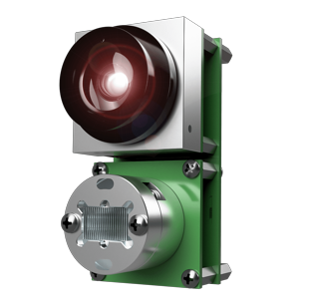
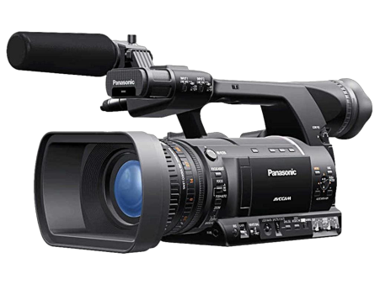
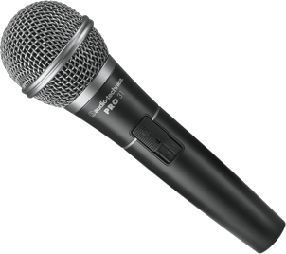
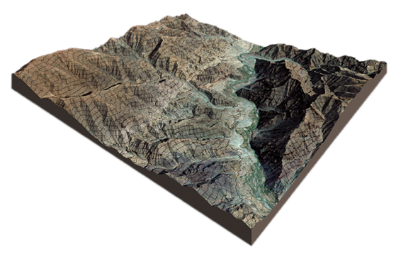
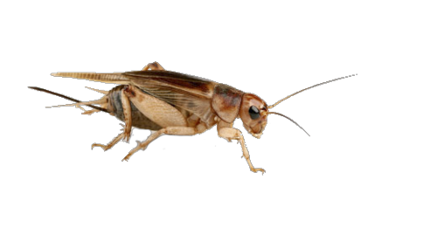
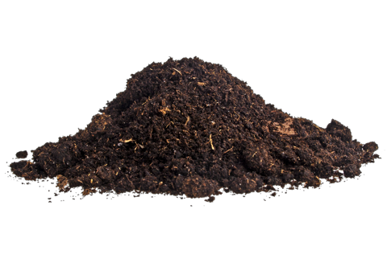
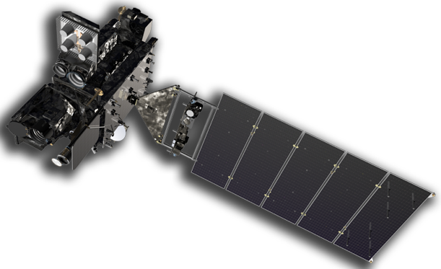
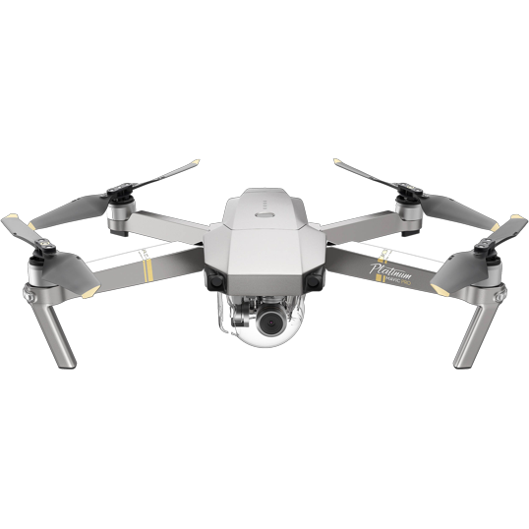

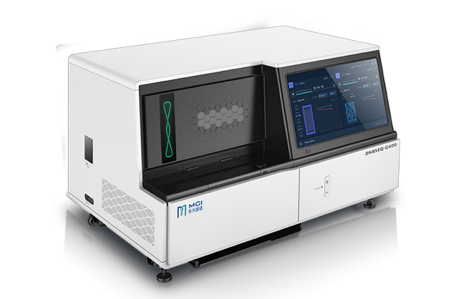
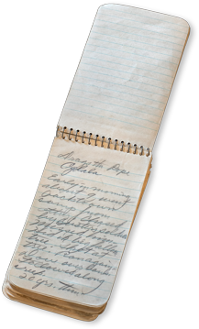
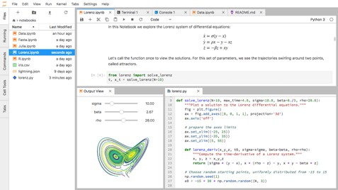
Examples for Research Data
Research data & Research data management
Audio and video recordings
Diaries
Geographic information system (GIS) data
Laboratory and field notebooks
Model, script and research software code
Pictures and figures
Questionnaires and codebooks
Samples and artifacts
Sensor data
Sequence data
Spectra
Text and spreadsheet documents
Text corpora and annotations
Topography data
Transcripts
Most pictures under CC-BY-NC by PNG All

Slide 10
Research Data Management
Think-Pair-Share
You will have fife minutes with your partner. Please discuss!
What do you think is research data management?
What might be the benefit of it?
Share your thoughts with us when you are back!

Slide 11
Research Data Management
Research Data Management
‘Research data management is an explicit process covering the creation and stewardship of research materials to enable their use for as long as they retain value.’ – DCC Glossary
‘Research Data Management (RDM) is the methodical handling of the information produced or re-used during the course of academic research.’ – University of Edinburgh Research Data Service

Slide 12
Research Data Management
What do you think is the benefit of good research data management?
Reproducibility of results
Findability of the data
Traceability of research
Transparency of research
Quality assurance and quality attribute
Efficiency in the research process
Sustainability
Knowledge generation
No redundancy
Structuring, organisation
Enable collaborations
…
…

Slide 13
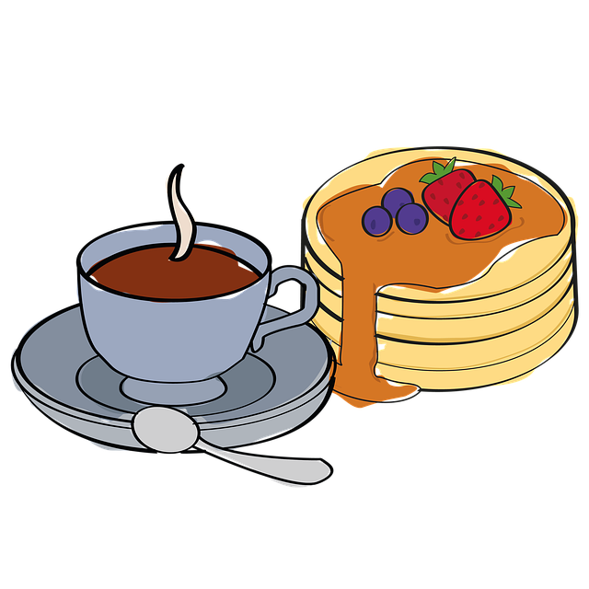
Have a break!
Break

Slide 14

Research Data Lifecycle
PLANNING RESEARCH
RE-USING DATA
COLLECTING DATA
PRESERVING DATA
PROCESSING AND ANALYSING DATA
PUBLISHING AND SHARING DATA

Slide 15
Individual work: You´ll have 15 Minutes. Please think about your own PhD project and add keywords to the stations of the research data lifecycle that describe what steps and procedures at each station are relevant to your research data. https://miro.com/app/board/uXjVO2tWOi4=/
Research Data Lifecycle
What about your own research project?
Can you map your own research project to this research data lifecycle?
Any deviations?
PLANNING RESEARCH
RE-USING DATA
COLLECTING DATA
PRESERVING DATA
PROCESSING AND ANALYSING DATA
PUBLISHING AND SHARING DATA

Slide 16
Organize your Files
Data organization
Try to find meaningful names ➞ no “fantasy names”
Use a uniform scheme and a logical structure
Folder structure and file names
Hierarchic order with first things first
Sorting!
Follow ISO 8601 for dates and times
Date & time, e.g., YYYYMMDDThhmmss±hhmm
Date, e.g., YYYY-MM-DD
Versions? Use the semantic versioning scheme (Major.Minor.Patch), e.g., 2.0.0
Avoid of blanks and special characters “🦄”
Document your naming conventions and abbreviations used
Readme.md
Notes:
Do you have naming conventions in your working group?

Slide 17
Examples for Naming Conventions
Data organization
Folder hierarchy /<Project name>/<Approach>/<Location>/<Person-ID>_<Date>.<Format-Suffix> /Rebel-Hunting/Interviews/DS-1_Orbital_Battle_Station/Organa_1976-05-25.mp4
File name <Project name>_<Approach>_<Location>_<Person-ID>_<Date>.<Format-Suffix> Rebel-Hunting_Interview_DS-1-Orbital-Battle-Station_Organa_1976-05-25.mp4
Notes:
Do you have naming conventions in your working group?

Slide 18
Version Control
Data organization
Store versions in separate files
Semantic versioning (Major.Minor.Patch), e.g.,
0.1.0 (a beta)
1.0.0 (a release version)
1.0.1 (a release with slight corrections)
Use a version control table and document your changes
E.g., Readme.md
Working in a team? A lot of changes? Use a distributed version control system!
Git
GitLab, GitHub
Notes:
Do you have naming conventions in your working group?

Slide 19
Which example are following a good naming convention?
Data organization
Olga_170413_probe17k
Naturepaper-marc-mira-ready!
Vm4520132Schmidt.pdf
647749157.pdf
Kristall_765_spektr_2016-12-03.csv
170413_probe17k_olga
Naturepaper+karl+britta+james&nal
Olga170413probe17k
Krst_765_spkt_161203
Naturepaper+karl+britta+james ready!_revised
012_maus_mrna_20200912
Nature_karl&jan_endendversion
28q8QGlHKwrRw.pdf
Tagung_Digitale_Wissenschaft.pdf
Notes:
Do you have naming conventions in your working group?

Slide 20
Data organization
Individual work or group work for people working on the same project
What would be a good folder structure and a good file naming convention for the files related to your PhD project?
Please document
(1.) to which files your folder structure and your naming convention applies,
(2.) a scratch of a folder structure,
(3.) the descriptive aspects to be used in file names and their order, and the
(4.) abbreviations used.
Create an own zumpad or use your working space on the miro-Board to take notes.

Slide 21
Have a break!
Break

Slide 22
Data documentation
Data documentation & metadata
Group work:
You receive a data set from a colleague: av_D.csv
What kind of data did you receive?
Apart from the data itself - what information do you need to be able to work with it?
https://zumpad.zum.de/p/2022-05-10_documentation_1
https://zumpad.zum.de/p/2022-05-10_documentation_2
https://zumpad.zum.de/p/2022-05-10_documentation_3
https://zumpad.zum.de/p/2022-05-10_documentation_4

Slide 23
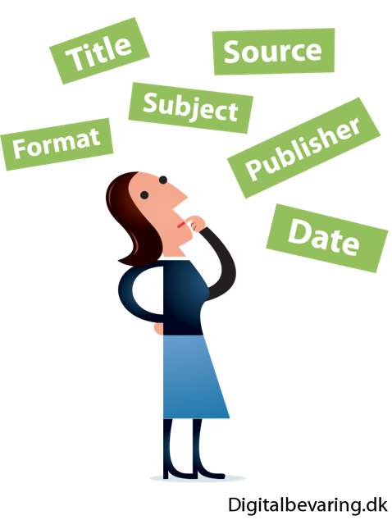
A good data documentation should include
Data documentation & metadata
Information on the collection of data
Methods, units, time periods, locations, technique used, etc.
Structure of the data and their mutual relationships
Explanation of variables, labels and codes
Differences between different data set versions
Measures for data cleaning
Information on access and terms of use
Licensing
Ideal world
Description of the research undertaking
Goals
Hypotheses

Slide 24
date
Data documentation & metadata
364.07

Slide 25
Data about Data
Data documentation & metadata
364.07
Identifier: 10.1594/dwd-weather-data
Identifier Type: DOI
Unit: K
Data Type Identifier: 11314.3/0a9062a9cb51995dea9f
Date: 2019-07-25T15:00:00Z
Location: 52.5178687 7.3057642
Creator: Deutscher Wetterdienst
ROR: 02nrqs528

Slide 26
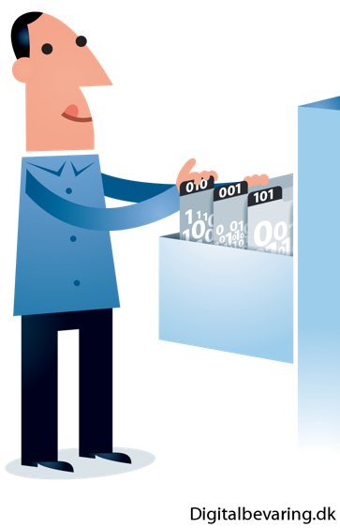

Data documentation & metadata
Origin, Location and Meaning of Data
364.07
Identifier: 10.1594/dwd-data-9891467 (fake)
Identifier Type: DOI
Unit: K
Data Type Identifier: 11314.3/0a9062a9cb51995dea9f
Date: 2019-07-25T15:00:00Z
Location: 52.5178687 7.3057642
Creator: Deutscher Wetterdienst
ROR: 02nrqs528
The DOI® System ISO 26324

Slide 27
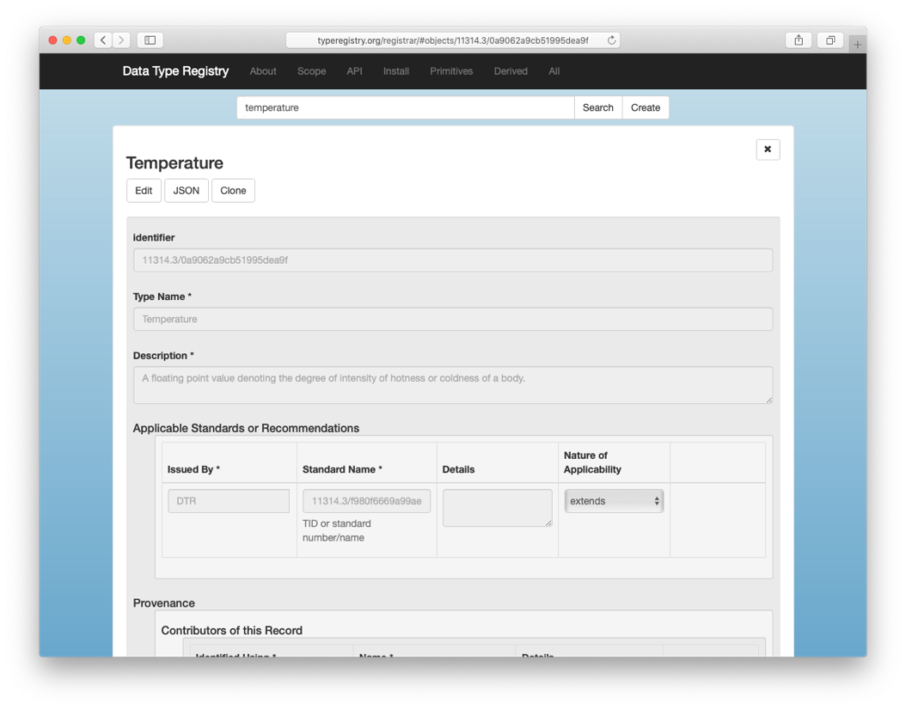
Origin, Location and Meaning of Data
Data documentation & metadata
364.07
Identifier: 10.1594/dwd-data-9891467 (fake)
Identifier Type: DOI
Unit: K
Data Type Identifier: 11314.3/0a9062a9cb51995dea9f
Date: 2019-07-25T15:00:00Z
Location: 52.5178687 7.3057642
Creator: Deutscher Wetterdienst
ROR: 02nrqs528
Temperature in Kelvin
364,07 K ≈ 42,6º C

Slide 28
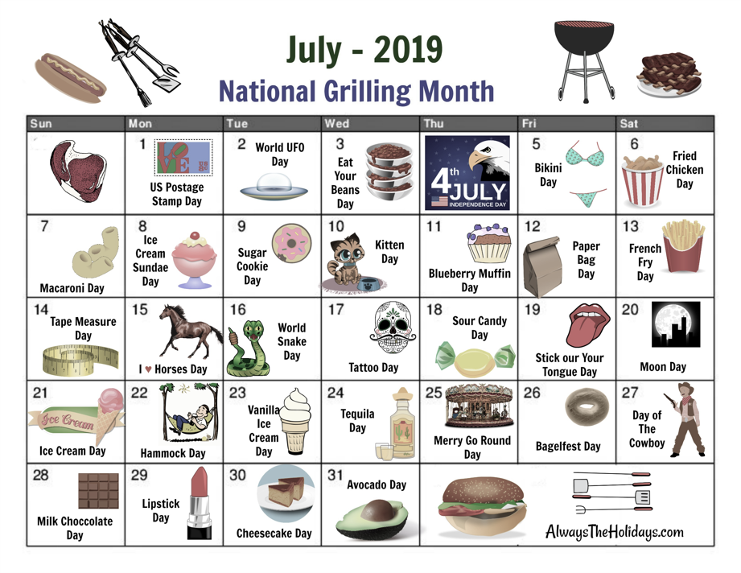

Origin, Location and Meaning of Data
Data documentation & metadata
364.07
Identifier: 10.1594/dwd-data-9891467 (fake)
Identifier Type: DOI
Unit: K
Data Type Identifier: 11314.3/0a9062a9cb51995dea9f
Date: 2019-07-25T15:00:00Z
Location: 52.5178687 7.3057642
Creator: Deutscher Wetterdienst
ROR: 02nrqs528

Slide 29
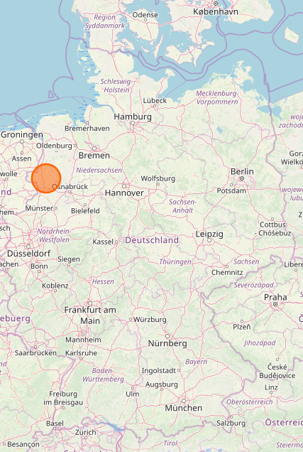
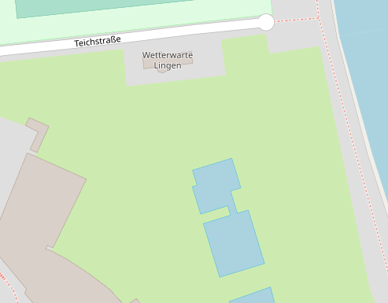
Location, Origin and Meaning of Data
Data documentation & metadata
364.07
Identifier: 10.1594/dwd-data-9891467 (fake)
Identifier Type: DOI
Unit: K
Data Type Identifier: 11314.3/0a9062a9cb51995dea9f
Date: 2019-07-25T15:00:00Z
Location: 52.5178687 7.3057642
Creator: Deutscher Wetterdienst
ROR: 02nrqs528
Wetterwarte Lingen
© OpenStreetMap contributors
© OpenStreetMap contributors

Slide 30
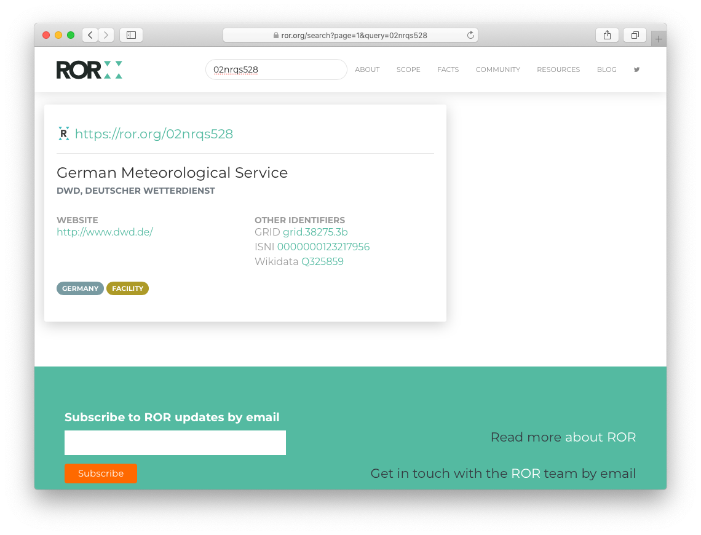
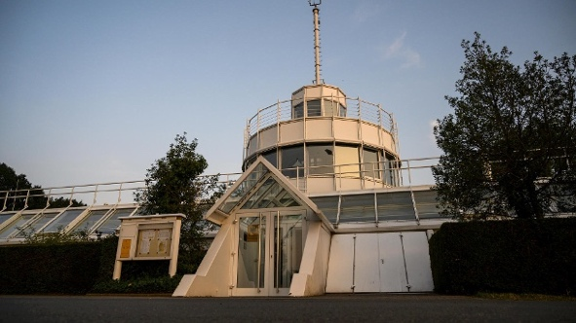

Origin, Location and Meaning of Data
Data documentation & metadata
364.07
Identifier: 10.1594/dwd-data-9891467 (fake)
Identifier Type: DOI
Unit: K
Data Type Identifier: 11314.3/0a9062a9cb51995dea9f
Date: 2019-07-25T15:00:00Z
Location: 52.5178687 7.3057642
Creator: Deutscher Wetterdienst
ROR: 02nrqs528
© dpa

Slide 31
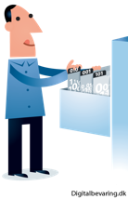

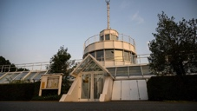

Origin, Location and Meaning of Data
Data documentation & metadata
364.07
Identifier: 10.1594/dwd-data-9891467 (fake)
Identifier Type: DOI
Unit: K
Data Type Identifier: 11314.3/0a9062a9cb51995dea9f
Date: 2019-07-25T15:00:00Z
Location: 52.5178687 7.3057642
Creator: Deutscher Wetterdienst
ROR: 02nrqs528
364,07 K ≈ 42,6º C

Slide 32
Origin, Location and Meaning of Data
Research data & Research data management
364.07
Identifier: 10.1594/dwd-data-9891467 (fake)
Identifier Type: DOI
Unit: K
Data Type Identifier: 11314.3/0a9062a9cb51995dea9f
Date: 2019-07-25T15:00:00Z
Location: 52.5178687 7.3057642
Creator: Deutscher Wetterdienst
ROR: 02nrqs528
Description: Air temperature measurement at the weather station Lingen, Germany, on 29 July 2019 in Kelvin
364,07 K ≈ 42,6º C

Slide 33
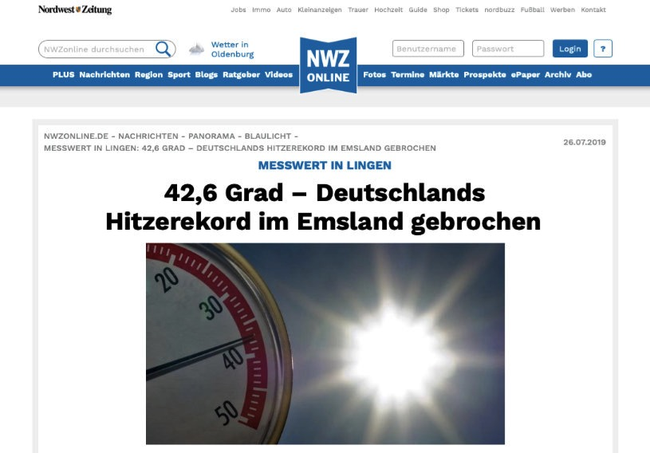
Traceability
Data documentation & metadata
364.07
© Nordwest Zeitung

Slide 34
Metadata
Data documentation & metadata
Data about data
Administrative data
Information on the management of the data
Mostly generic
Subject data
Individual aspects or data sets in more detail
Structured with respect to the research discipline
Generic standards
DataCite Metadata Schema
Dublin Core Metadata Initiative
Discipline-specific standards
Metadata Standards Directory

Slide 35
Metadata
Data documentation & metadata
Individual work:
Go to
http://rd-alliance.github.io/metadata-directory/subjects/
Search for a meta data standard appropriate to your
research subject!
There is no standard? What can you do?

Slide 36
Please post all file formats you work with in the context of your doctoral thesis to the miro-Board. https://miro.com/app/board/uXjVO2tWOi4=/
Data formats

Slide 37
File Formats
Data formats
Non-Proprietary, unencrypted, uncompressed and commonly used
Open-standard-compliant, documented and royalty-free
Data Type | Recommended | Trade-off Matter | Not Recommented
Tabular | CSV, TSV, ODS | XLSX, SPSS portable | XLS, SPSS
Textual | TXT, MD, HTML, ODT | DOCX, RTF, PDF/A | DOC, PDF, PS
Presentation | ODP, HTML | PPTX | PPT
Video | MP4, MKV, OGG | WEBM | WMV, MOV, QT, Flash
Audio | MP4, FLAC, WAV, OGG | MP3, AIF
Image | TIFF, PNG | BMP, JPG | PSD, GIF
Vector | SVG |  | AI
Generic | XML, JSON, RDF
Container | Bagit, Frictionless Data Package | ZIP, TAR

Slide 38
Where do you store your data?
Back up & long-term storage

Slide 39
Recommendations for your back up
Back up & long-term storage
At least 3 copies of a file
On at least 2 different media
At least one of which is remote
Test data recovery at the beginning and at regular intervals.
Protect your (sensitive) data:
Hardware (e.g. separate lockable room).
File encryption
Password security
At least two people should have access to your data

Slide 40
Back up vs. long-term storage
Back up & long-term storage
Back up | Long-term storage
Automatic backup of all data to prevent data loss (technical, e.g. defective, or human, e.g. accidentally deleted) All versions | Storage of only selected data Final versions only Integrity backup Long-term storage Searchability

Slide 41

FAIR Data Principles
FAIR Data Principles
Findable
F1. (Meta)data are assigned a globally unique and persistent identifier
F2. Data are described with rich metadata (defined by R1 below)
F3. Metadata clearly and explicitly include the identifier of the data they describe
F4. (Meta)data are registered or indexed in a searchable resource
Accessible
A1. (Meta)data are retrievable by their identifier using a standardised communications protocol
A1.1 The protocol is open, free, and universally implementable
A1.2 The protocol allows for an authentication and authorisation procedure, where necessary
A2. Metadata are accessible, even when the data are no longer available

Slide 42
FAIR Data Principles (cont’d)
FAIR Data Principles
Interoperable
I1. (Meta)data use a formal, accessible, shared, and broadly applicable language for knowledge representation.
I2. (Meta)data use vocabularies that follow FAIR principles
I3. (Meta)data include qualified references to other (meta)data
Reusable
R1. Meta(data) are richly described with a plurality of accurate and relevant attributes
R1.1. (Meta)data are released with a clear and accessible data usage license
R1.2. (Meta)data are associated with detailed provenance
R1.3. (Meta)data meet domain-relevant community standards

Slide 43
FAIR Data Principles
FAIR Data Principles
Think about your own project and evaluate the handling of your research data against the FAIR principles.
Which of the FAIR principles do you already comply with?
And where do you need to improve?
What do you need in order to comply with the FAIR principles?

Slide 44

Open Access
Open X
Distribution of research output online, freely available for everyone
Panton Principles: no restrictions for use und republication
In practice: attribution to the original author or creator
Attribution stacking
Formerly only open publication of journal articles, papers, etc.
Part of Open Science
Like Open Educational Resources, Open Source Research Software, Open Methodology, Citizen Science
Open Data
Publication of data without legal or technical restrictions
Indispensable for data science
Generic non-proprietary formats
Metadata
FAIR?

Slide 45
How to publish and share your data?
Publication
Supplement to a peer-reviewed article ("enhanced publication")
Independent information object in a research data repository
Data journals

Slide 46
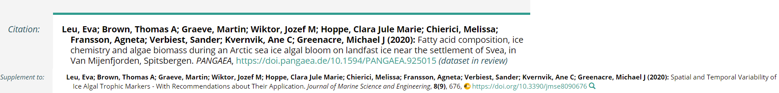
Supplement to a peer-reviewed article ("enhanced publication"):
Publication
as a supplement to the associated article
as a data set in a repository with a link to the corresponding article.
Example:
Quelle: https://doi.pangaea.de/10.1594/PANGAEA.925015

Slide 47
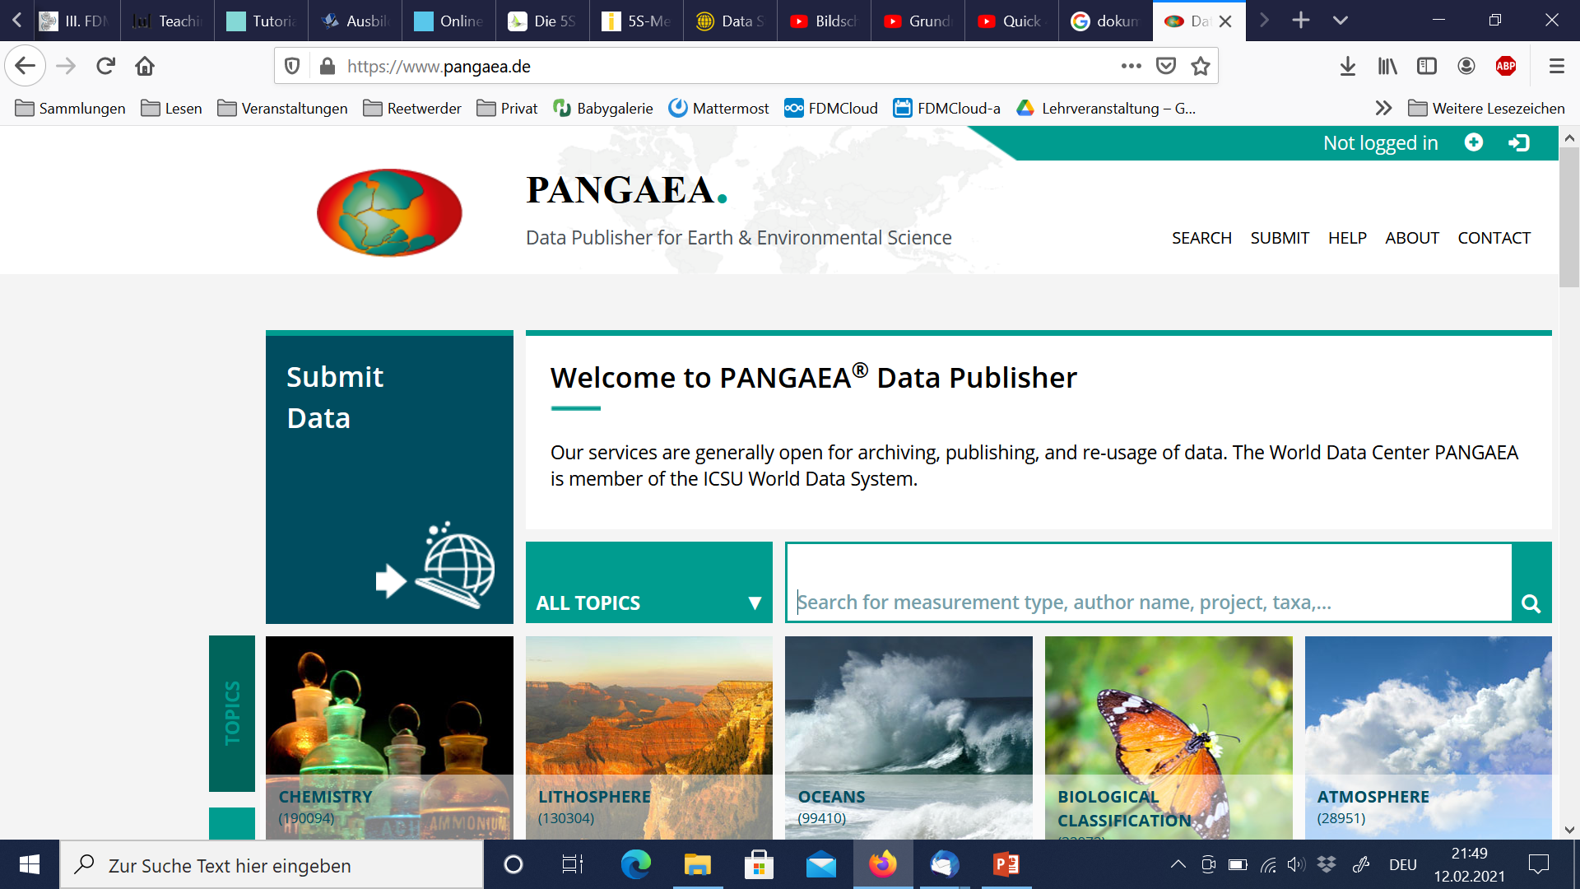
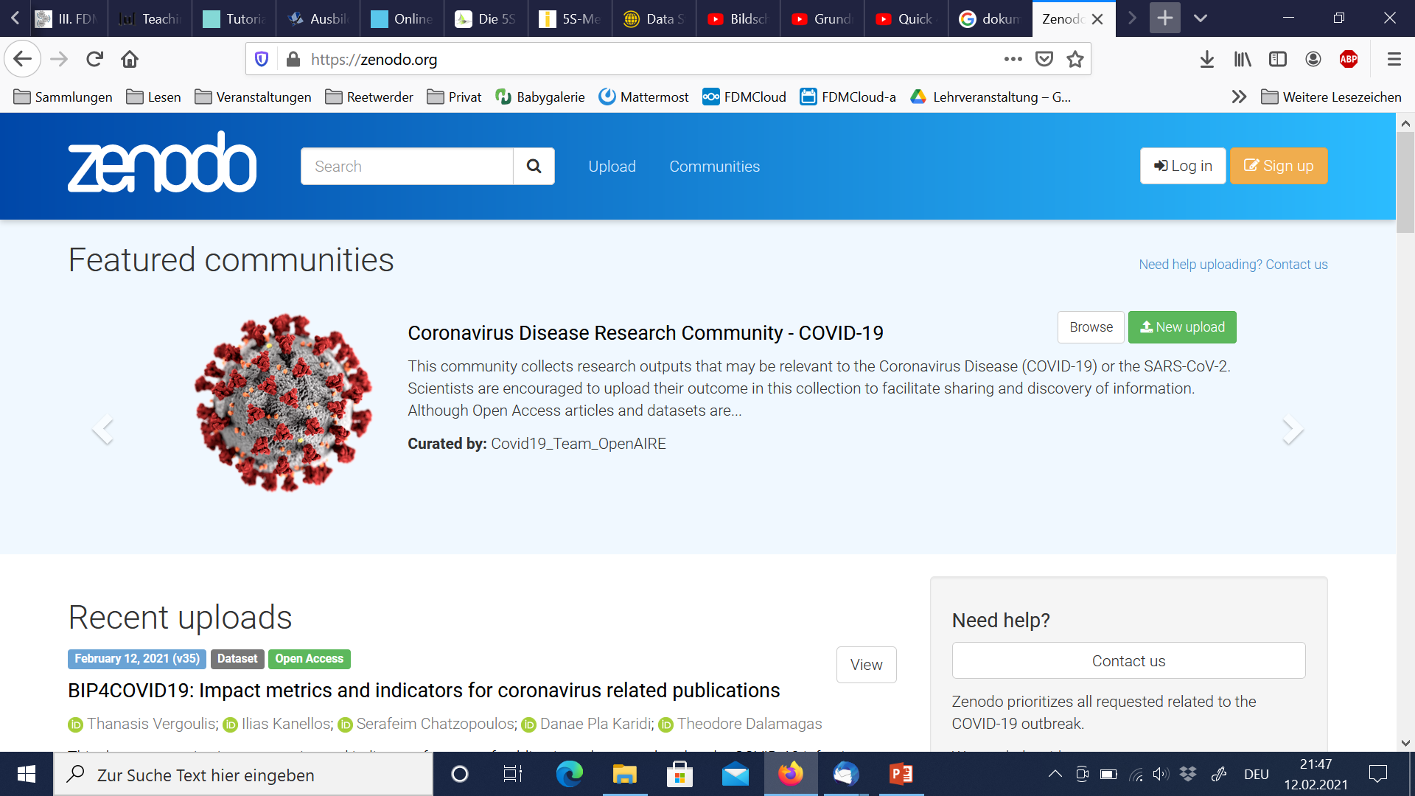
Stand-alone information object in a research data repository:
Publication
disziplinspezifische Repositorien, z. B. Datorium, Pangaea
disziplinübergreifende Repositorien, z. B. ZENODO
institutionelle Repositorien, z. B. Refubium, edoc
Example:
Quelle: https://www.pangaea.de/, Zugriff 10.02.2021
Quelle: https://zenodo.org/, Zugriff 10.02.2021

Slide 48
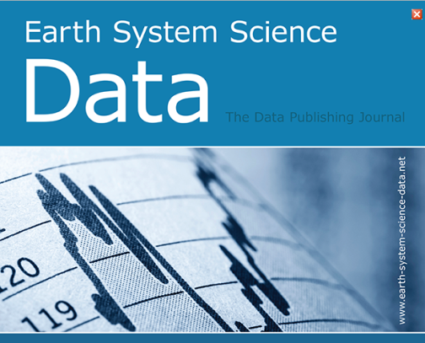
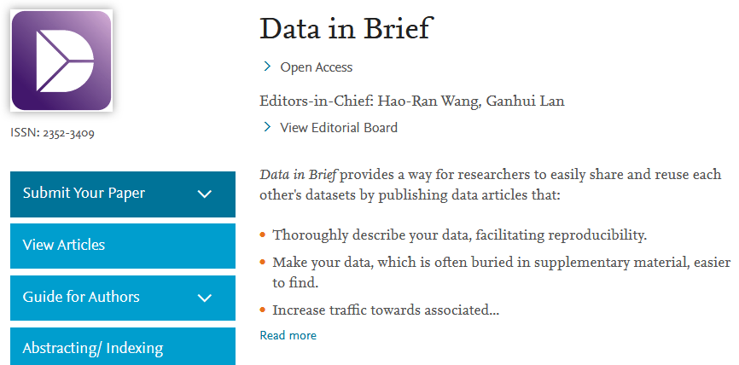
Data Journals
Publication
publish detailed description of data
partly peer-reviewed
Example:
Quelle: https://www.earth-system-science-data.net, Zugriff 10.02.2021
Quelle: https://www.journals.elsevier.com/data-in-brief, Zugriff 10.02.2021

Slide 49
What is a repository?
Publication
"A repository (Latin repositorium, 'storehouse') is a managed place for storing ordered documents that are accessible to the public or to a restricted group of users.An archive (Latin archivum, file cabinet'), on the other hand, manages only historical documents.“
"Digital research data repositories are information infrastructures that store and organize digital research data...as permanently as possible...to ensure the discoverability and accessibility of the data...“
Source: Esther Asef, Katarzyna Biernacka, Elisabeth Böker,Sarah Ann Danker, Juliane Jacob, Janna Neumann, Britta Petersen, Jessica Rex und Ute Trautwein-Bruns (2021): Data Sharing interaktiv vermitteln

Slide 50
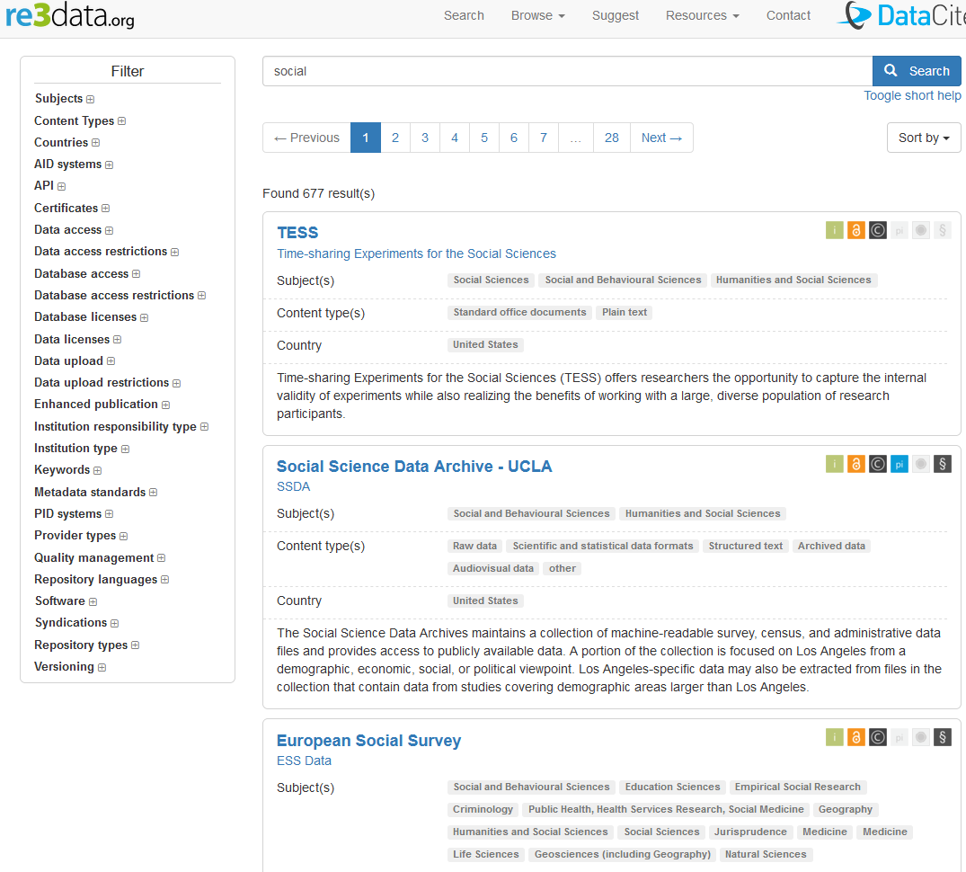
How to find a repository?
Publication
Use re3data.org
Collection of repositories
Worldwide
Various disciplines
Researchers, funders, publishers and institutions
Quelle: re3data About. http://service.re3data.org/about. Zugriff 10.02.2021

Slide 51
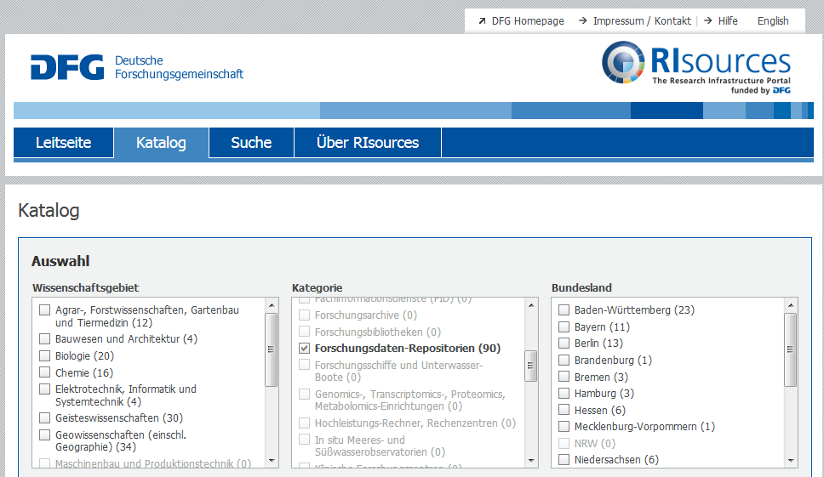
How to find a repository?
Publication
risources.dfg.de
Offer of the DFG
Information portal
Germany-wide
Research Infrastructures
For researchers
Quelle: http://risources.dfg.de/index.html#q=*&sort=RI_SORT_DE%20asc&rows=10&RI_EXT=Y. Zugriff 10.02.2021

Slide 52
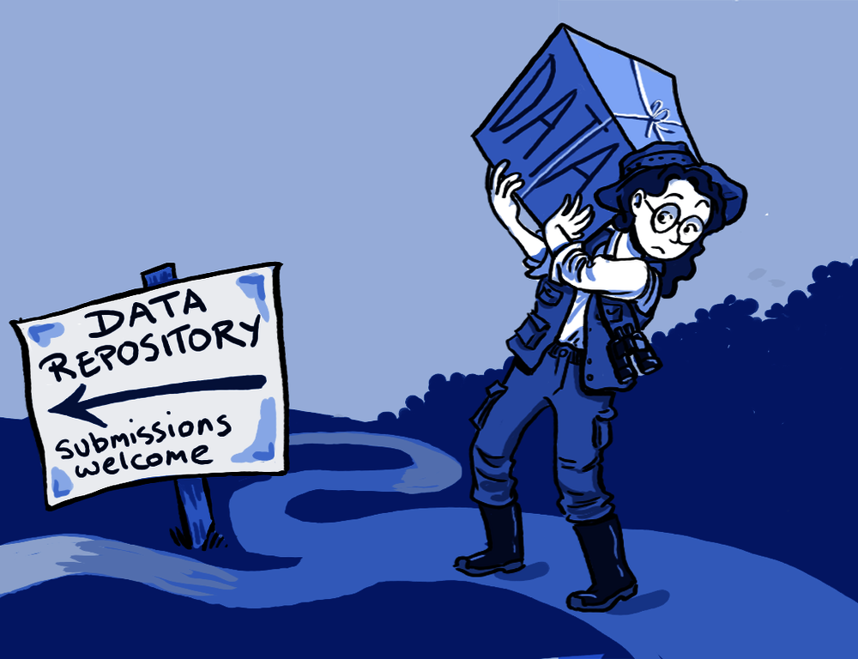
Publication
Task:
Search re3data.org for a repository that is appropriate for your data.
Let us discuss your search and selection.

Slide 53
Licences
Publication
Licenses regulate conditions of subsequent use of published data.
Free licenses allow the use, redistribution and modification of copyrighted works
are usually available for free use and only need to be linked to
Prerequisite is that you are the copyright holder
Selection of the license depends on the type of data:
e.g. Creative Commons (CC) licenses for articles, monographs, images, etc.
Open-Database-License (ODbL) for DB or CC starting with version 4
General Public Licence (GNU) for software
If no license is granted, the stricter copyright applies, as far as applicable to data

Slide 54





CC-Licenses
Publication
CC0 (Public Domain)
CC BY (Namensnennung)
CC BY-SA (Namensnennung - Weitergabe unter gleichen Bedingungen)
CC BY-ND (Namensnennung - Keine Bearbeitung)
CC BY-NC (Namensnennung - Nicht kommerziell)
CC BY-NC-SA (Namensnennung - Nicht-kommerziell - Weitergabe unter gleichen Bedingungen)
CC BY-NC-ND (Namensnennung - Nicht-kommerziell - Keine Bearbeitung)

Slide 55
Take care!
Publication
No license
≠
free license

Slide 56
What is a data management plan?
Data management plan
All information that adequately describes and documents the collection, processing, storage, archiving, and publication of research data in the context of a research project.
"[...] analysis of the workflow from the generation of the data to their use.“¹
[1] J. Ludwig, H. Enke (Hrsg.) Leitfaden zum Forschungsdaten-Management. Handreichungen aus dem WissGrid-Projekt. Verlag Werner Hülsbusch: Glückstadt, 2013.

Slide 57
Components of a DMP
Data management plan
Administrative information
Project name, data originator, other contributors, contact, funding program, etc.
Project abstract
Data set descriptions
Data types, formats, scope
Metadata and standards information
Data sharing
Archiving and backup of data
Responsibilities
Legal and ethical aspects (e.g., licences, GDPR, Nagoya protocol, CARE)
Costs
Length can vary from a few paragraphs to several pages!

Slide 58
Sketching out a DMP for your research project
Data management plan
Individual work:
Please download the CAU template for data management plans: CAU_DMP_Template
You have 10 minutes. Have look at the template and try to sketch out a DMP for your research project. What information do you already have? What information is missing to fill the template?

Slide 59

Research Data Alliance
RDM related & funding organizations
International organisation founded in 2012
Vision: Researchers and innovators openly share data across technologies, disciplines, and countries to address the grand challenges of society
Mission: RDA builds the social and technical bridges that enable open sharing of data
Bottom-up development of practices, infrastructures, tools, technologies, services, approaches, policies, etc.
Practitioners come together in Birds of a Feather-Groups (BoF), Interest Groups (IG) or Working Groups (WG)
Regional chapters, e.g., RDA Europe or RDA Deutschland e.V.
Strong influence on European Commission, BMBF, DFG, …

Slide 60

Nationale Forschungsdateninfrastruktur (NFDI)
RDM related & funding organizations
National research data management initiative in Germany
Initiated by the German Council for Scientific Information Infrastructures
Horizontal linking of existing actors
Discipline-specific NFDI consortia with with binding roadmaps
Bring into use existing infrastructure
Identify and fill gaps
Interoperability of data and infrastructure
Use of NFDI will probably get mandatory
Participation in the work of NFDI consortia possible

Slide 61

Deutsche Forschungsgemeinschaft (DFG)
RDM related & funding organizations
Code of Conduct Guidelines for Safeguarding Good Research Practice
Guideline 7 – Quality assurance
Disclosing of origin of data, organisms, materials and software used
Reuse of data is clearly indicated; original sources are cited
Description of nature and scope of research data generated
Handling of research data in accordance with requirements of relevant subject area
Guideline 13 – Public access
Making available research data where possible and reasonable
Making available software programmed by researchers with source code
FAIR Principles

Slide 62

Horizon 2020 & Horizon Europe
RDM related & funding organizations
Framework Programme for Research and Technological Development of the European Comission
Horizon 2020 Online Manual – Data Management
Horizon Europe – Programme Guide – Open Science
Horizon Europe – Data Management Plan Template
Open access to research data is applicable by default
as open as possible, as closed as necessary
Make research data findable, accessible, interoperable and re-usable (FAIR)
DMP should include information on:
The handling of research data during & after the end of the project
What data will be collected, processed and/or generated
Which methodology & standards will be applied
Whether data will be shared/made open access and
How data will be curated & preserved (including after the end of the project)

Slide 63
CAU Guideline on Research Data Management
CAU guidelines
Individual work:
You have 5 minutes to perform an internet search!
Are there any guidelines for handling research data at CAU?
Are there specific guidelines for handling research data at your institute?
Who are the contact persons at CAU and/or your institute if you have questions about handling your digital research data?

Slide 64
CAU Guideline on Research Data Management
CAU
Kiel University’s Recommendations on Handling Research Data
Research data are the basis and result of scientific work and are therefore of particular significance. It is important to handle research data responsibly to ensure that scientific work is traceable, verifiable and reusable
Handling research data is subject to constant change due to advances in research
Kiel University continuously assists with this ongoing process by implementing appropriate measures

Slide 65
CAU Guideline on Research Data Management (cont’d)
CAU
Principle 1
Research data are all data created in the process of research work through observation, collection, experiments, simulation, and further processing for the purpose of producing and validating research results
Research data management covers all areas of data administration: data acquisition, data preservation, data security and data integrity, as well as the release and publication of data

Slide 66
CAU Guideline on Research Data Management (cont’d)
CAU
Principle 2
Research data management is performed in accordance with current professional standards while respecting the DFG (German Research Foundation) proposals for safeguarding good scientific practice
Research data management is documented in a data management plan
Responsibility for research data management lies with the head of the particular research activity.

Slide 67
CAU Guideline on Research Data Management (cont’d)
CAU
Principle 3
Research data is made accessible to the public in national or international subject-specific archives under appropriate licensing; if no such archives exist, central university services are used
Scientific and legal interests of the researchers, the protection of the personal details of participants, patients and other individuals affected by the collected data, as well as other obligations to third parties – for example, cooperation partners – as well as ethical, legal and economic restrictions must be observed

Slide 68
CAU Guideline on Research Data Management (cont’d)
CAU
Principle 3
Kiel University assists researchers through its central infrastructure facilities
Acquisition and preservation of research data
Formulating and maintaining standards for handling research data
Appropriate training and advisory service offers created in cooperation with the specialist disciplines
Kiel University recommends and assists with anchoring the significance of subject-specific, structured research data management in teaching by the particular subject areas

Slide 69
Practical Take-Away Messages
Take-Away Messages
Formats
Generic and open standard file formats last longer than proprietary file formats
Open Document Format (ODF)
Comma separated values (CSV)
Raw text files (TXT, MD)
Data container formats for exchange, archival and publication, e.g., BagIt, Frictionless Data
Storage
Central infrastructure with backup for storage
Desktop and laptop for work on current research data only
Systematic file and folder naming and hierarchy
Provide Readme files
Data Management Middleware for handling data and metadata, e.g., iRODS
DFG Guidelines for Safeguarding Good Research Practice require 10 years of preservation at least!

Slide 70
Practical Take-Away Messages (cont’d)
Take-Away Messages
Publication
Discipline-specific Repositories with specific metadata support
re3data: Registry of Research Repositories
National or international initiatives
NFDI (work in progress)
European Open Science Cloud Services
Institutional Data Repository (work in progress)
Generic Repositories
Zenodo
Licensing
Creative Commons: data with a necessary creation height; ideally CC0 or CC BY
Open Data Commons: databases, raw data

Slide 71
Questions
?
Nearly done!
?
?
Thilo Paul-Stüve
Christian-Albrechts-Universität zu Kiel Forschungsdatenmanagement
paul-stueve@rz.uni-kiel.de
?
?
Time for open questions!
This work is licensed under a Creative Commons Attribution 4.0 International License with exception of the used material from other copyright holders.

Slide 72
Feedback
One Minute Paper
Please take a piece of paper or create an own pad.
You have one minute.
Please write down the most important points of our workshop today.
Thilo Paul-Stüve
Christian-Albrechts-Universität zu Kiel Forschungsdatenmanagement
paul-stueve@rz.uni-kiel.de
This work is licensed under a Creative Commons Attribution 4.0 International License with exception of the used material from other copyright holders.

Slide 73
Feedback
Feedback
You have a date with some friends tonight. Your friends remember that you attended a workshop on research data management today and asks: “Well, how was it”?
What do you answer?
Thilo Paul-Stüve
Christian-Albrechts-Universität zu Kiel Forschungsdatenmanagement
paul-stueve@rz.uni-kiel.de
This work is licensed under a Creative Commons Attribution 4.0 International License with exception of the used material from other copyright holders.

Slide 74
CAU contacts
CAU contacts
https://www.fdm.uni-kiel.de/de/team
Thilo Paul-Stüve
Christian-Albrechts-Universität zu Kiel Forschungsdatenmanagement
paul-stueve@rz.uni-kiel.de
This work is licensed under a Creative Commons Attribution 4.0 International License with exception of the used material from other copyright holders.

Slide 75
Thank you!
Thilo Paul-Stüve
Christian-Albrechts-Universität zu Kiel Forschungsdatenmanagement
paul-stueve@rz.uni-kiel.de
This work is licensed under a Creative Commons Attribution 4.0 International License with exception of the used material from other copyright holders.

